Slide 1

Global super store
The Kartik Analytics

Slide 2

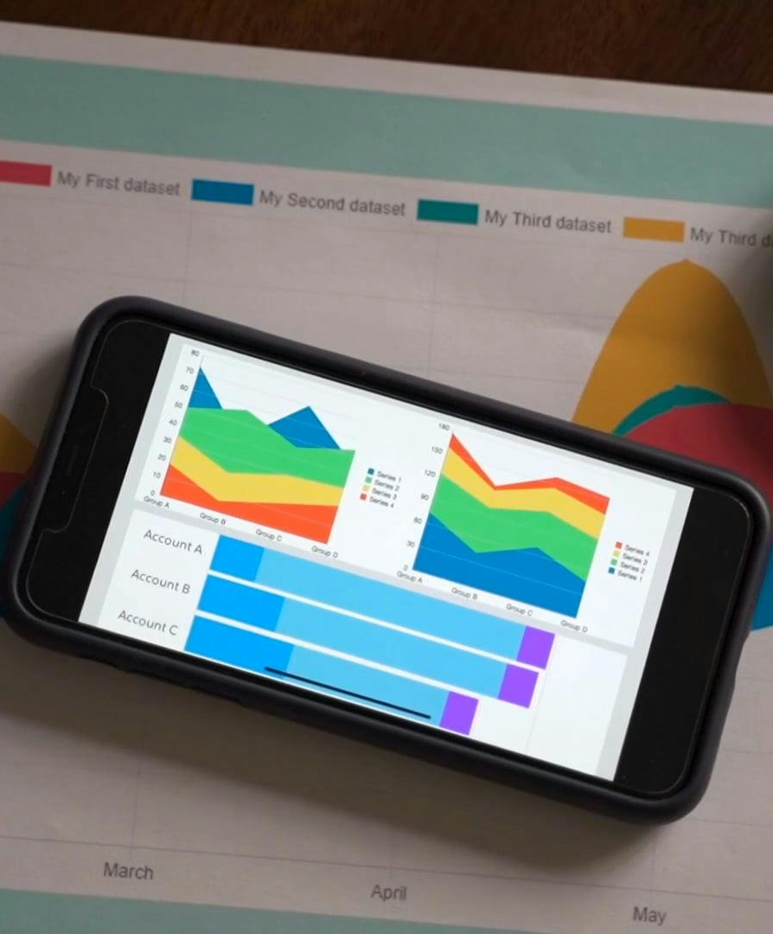
Sales & profit Analysis

Slide 3

Project Objective
To develop a comprehensive Sales and Profit analysis dashboard that provides real-time insights into key performance metrics and trends, enabling stakeholders to monitor and analyze credit card operations effectively.

Slide 4
Insights
Western Europe REGION is providing the highest sale and the highest profit
EUROPEAN MARKET PROVIDING THE HIGHEST PROFIT
Total Profit $1.39m
Total Sale $11.99M
Total Quantity SOLD 169K
Total orders 48.69k

Slide 5
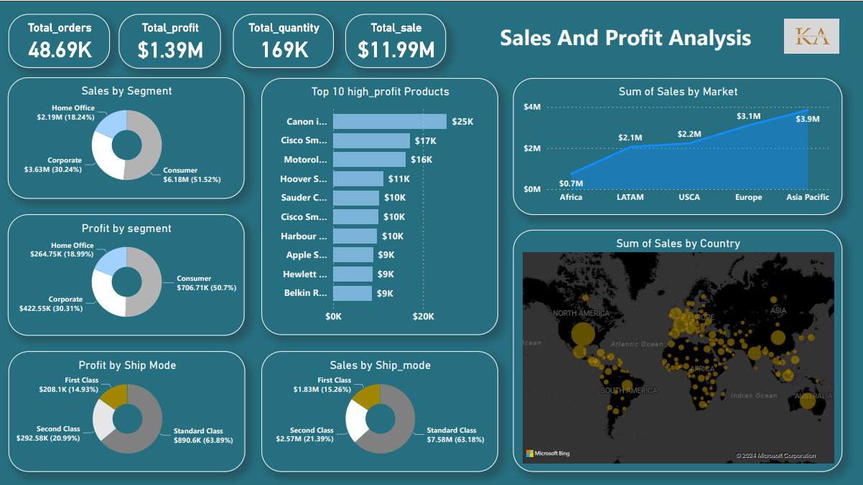
Dashboard1

Slide 6
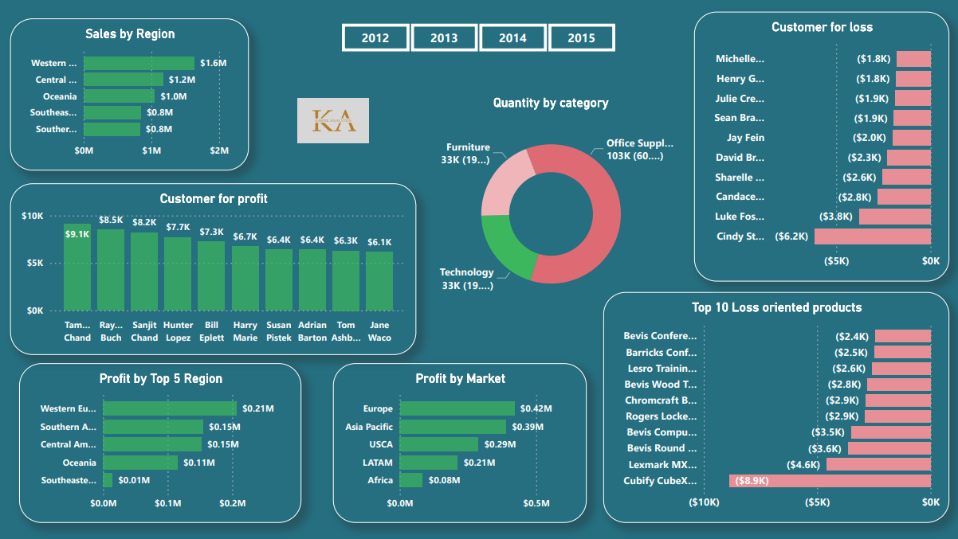
Dashboard2

Slide 7


SUMMARY
Total Profit $1.39m
Total Sale $11.99M
Total Quantity SOLD 169K
Total orders 48.69k
Western Europe REGION is providing the highest sale and the highest profit
EUROPEAN MARKET PROVIDING THE HIGHEST PROFIT
Consumer Segment is providing the highest sale and the highest profit

Slide 8
THANK YOU
The Kartik Analytics
Thekartikanalytics21@gmail.com
Upadhyayk629@gmail.com

